Slide 1
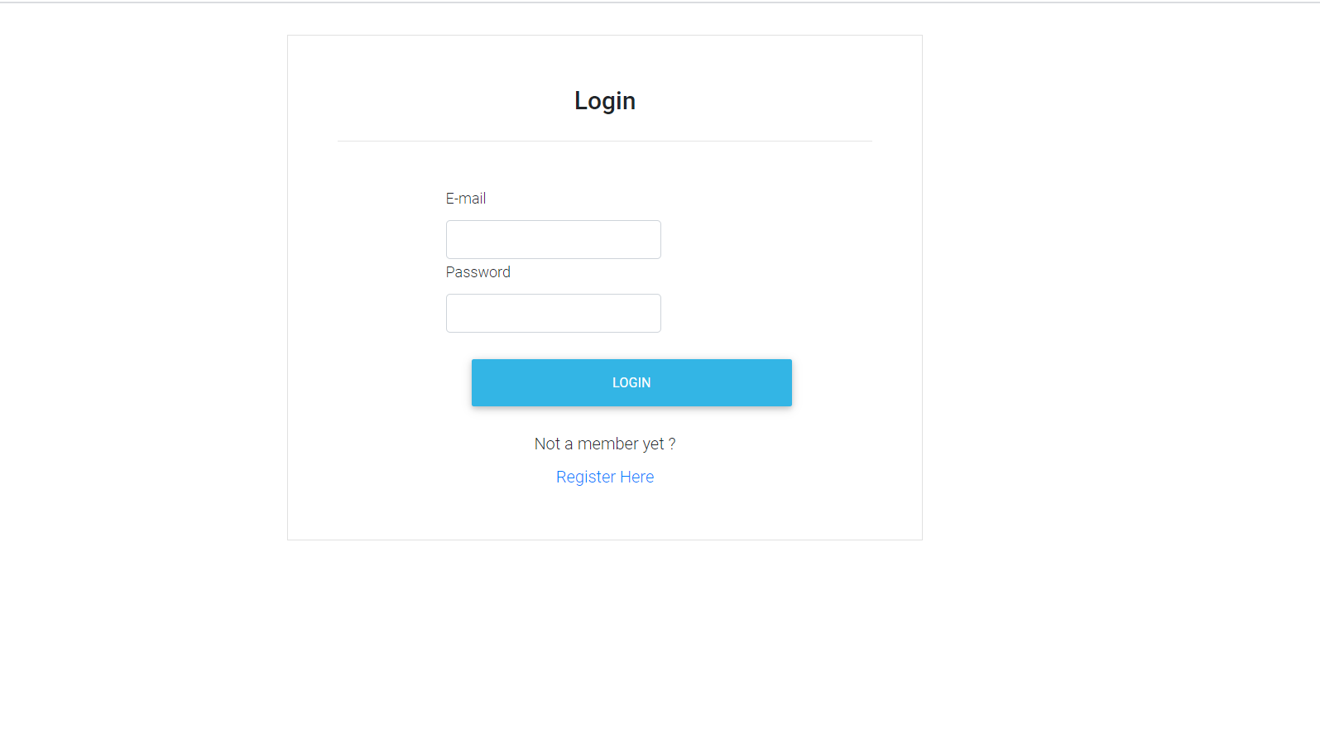
Admin Login:
Enter the registered mail Id and password.

Slide 2
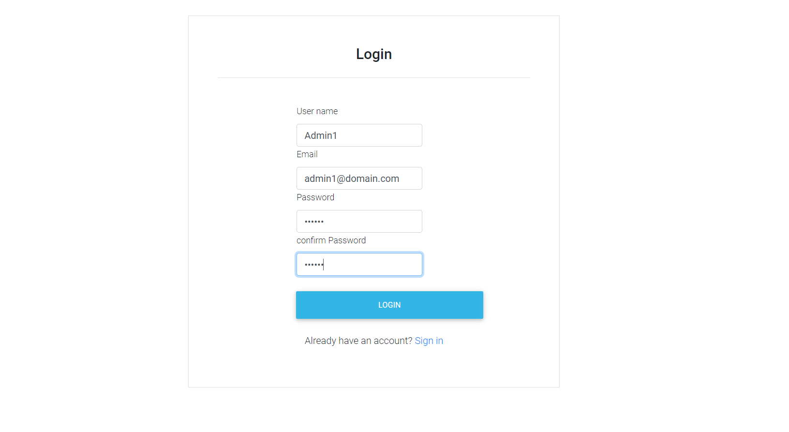


Admin Register:
Enter the required fields.

Slide 3
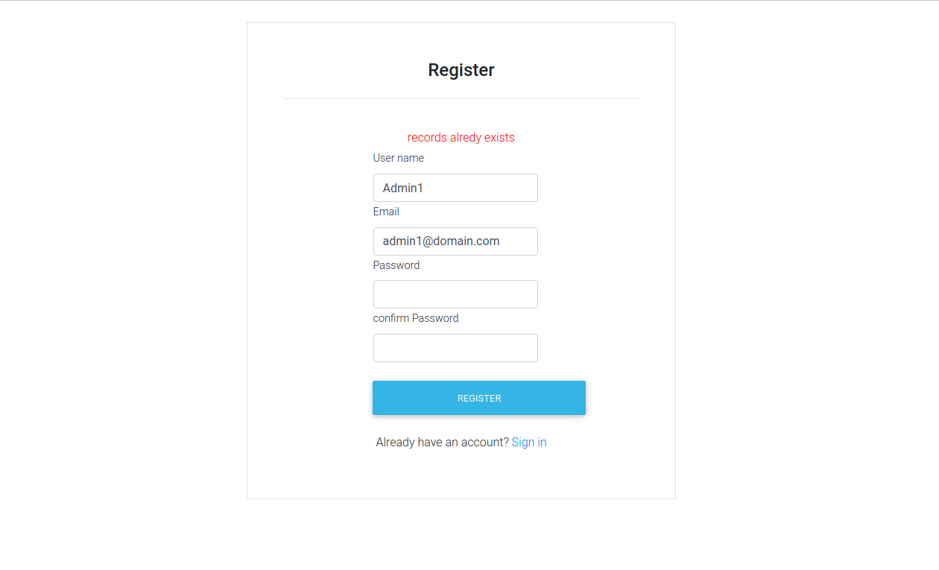
Admin Register failure:
Registration is failed when the same mail id is entered which is already registered.

Slide 4
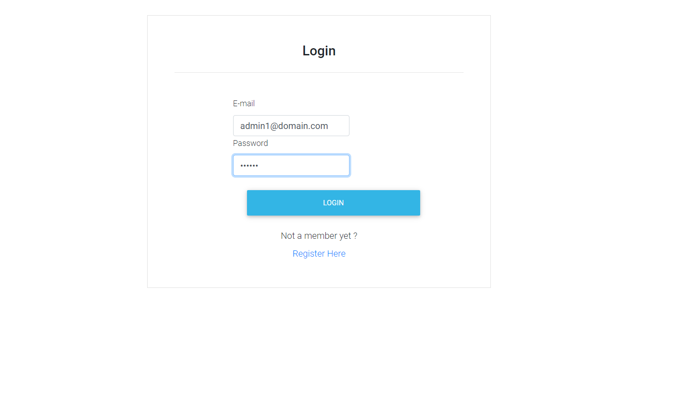
After successful registration, redirects to Login.
Enter the registered mail Id and password.

Slide 5
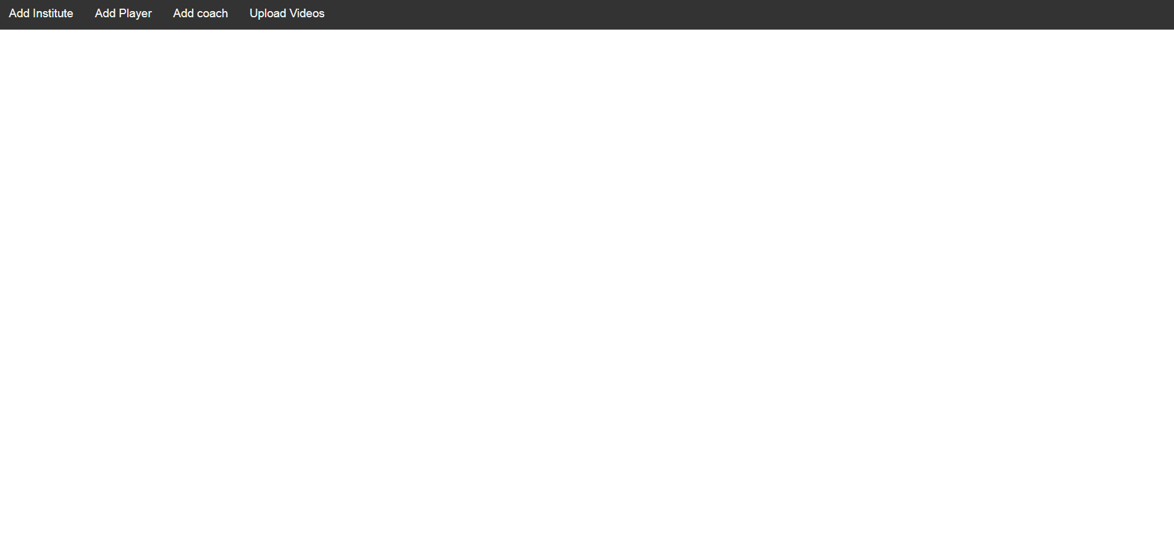


After successful Login.

Slide 6
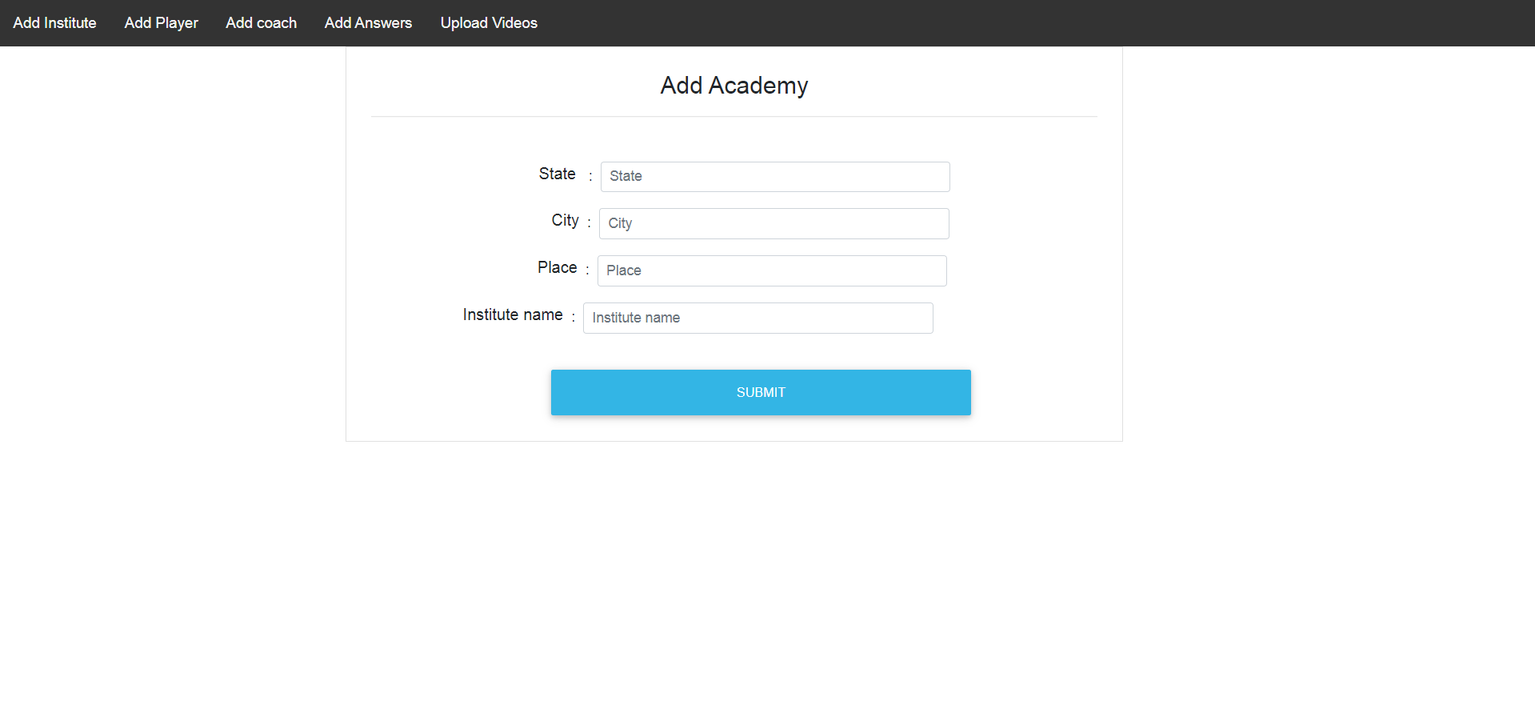

Add Institute page to add new institute.

Slide 7
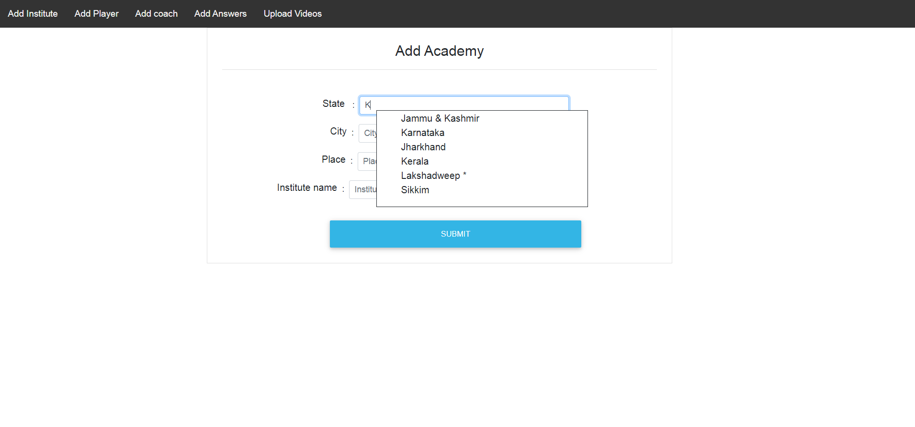
Select the state.

Slide 8
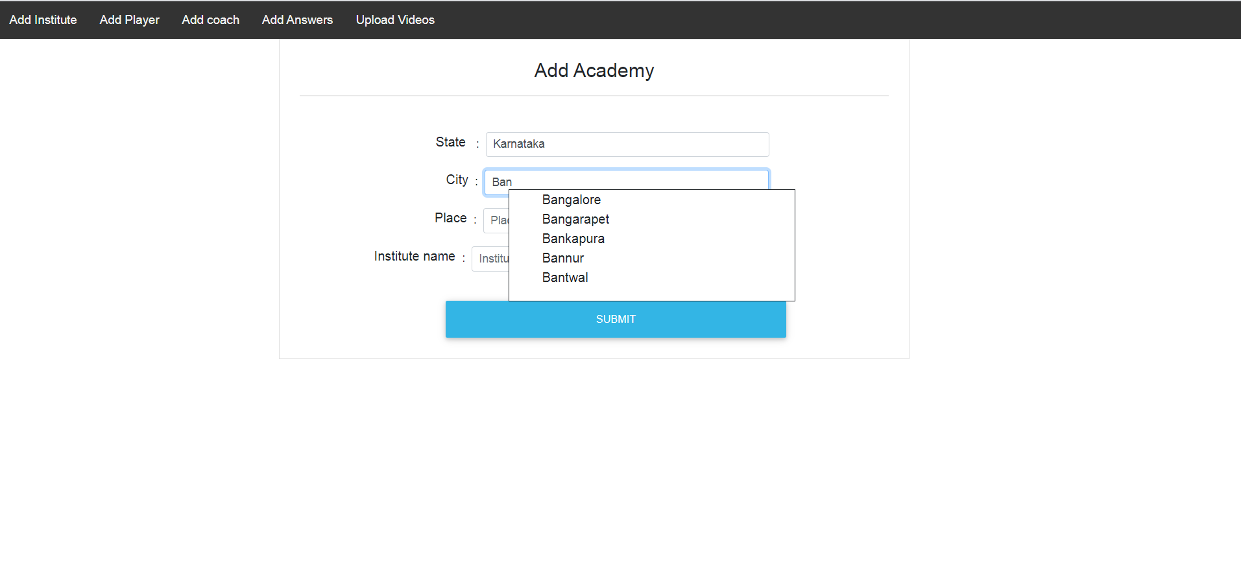
Select the city associated with state.

Slide 9
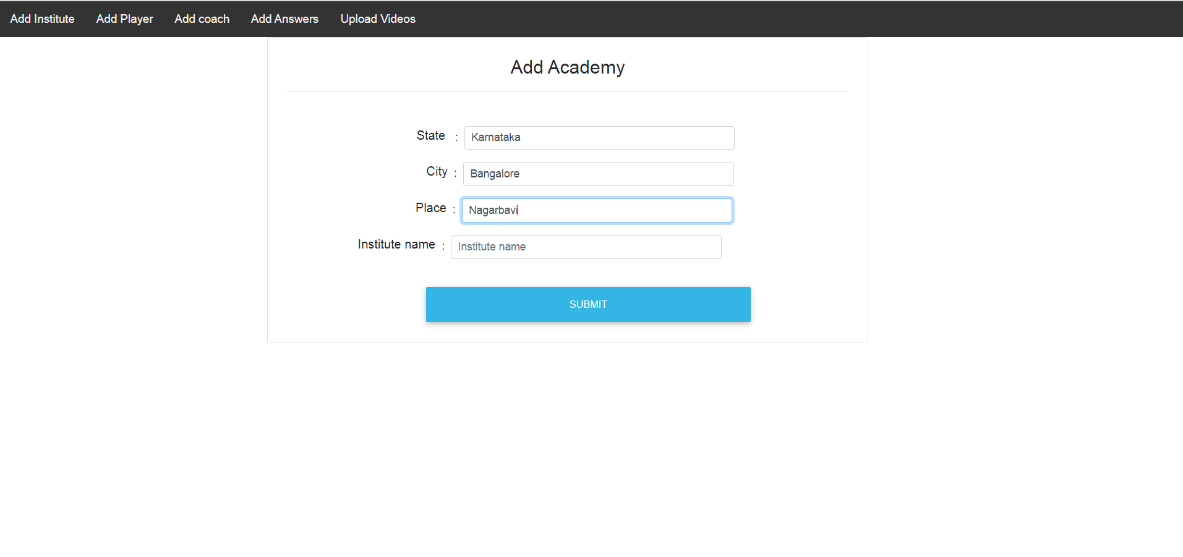
Enter the location.

Slide 10
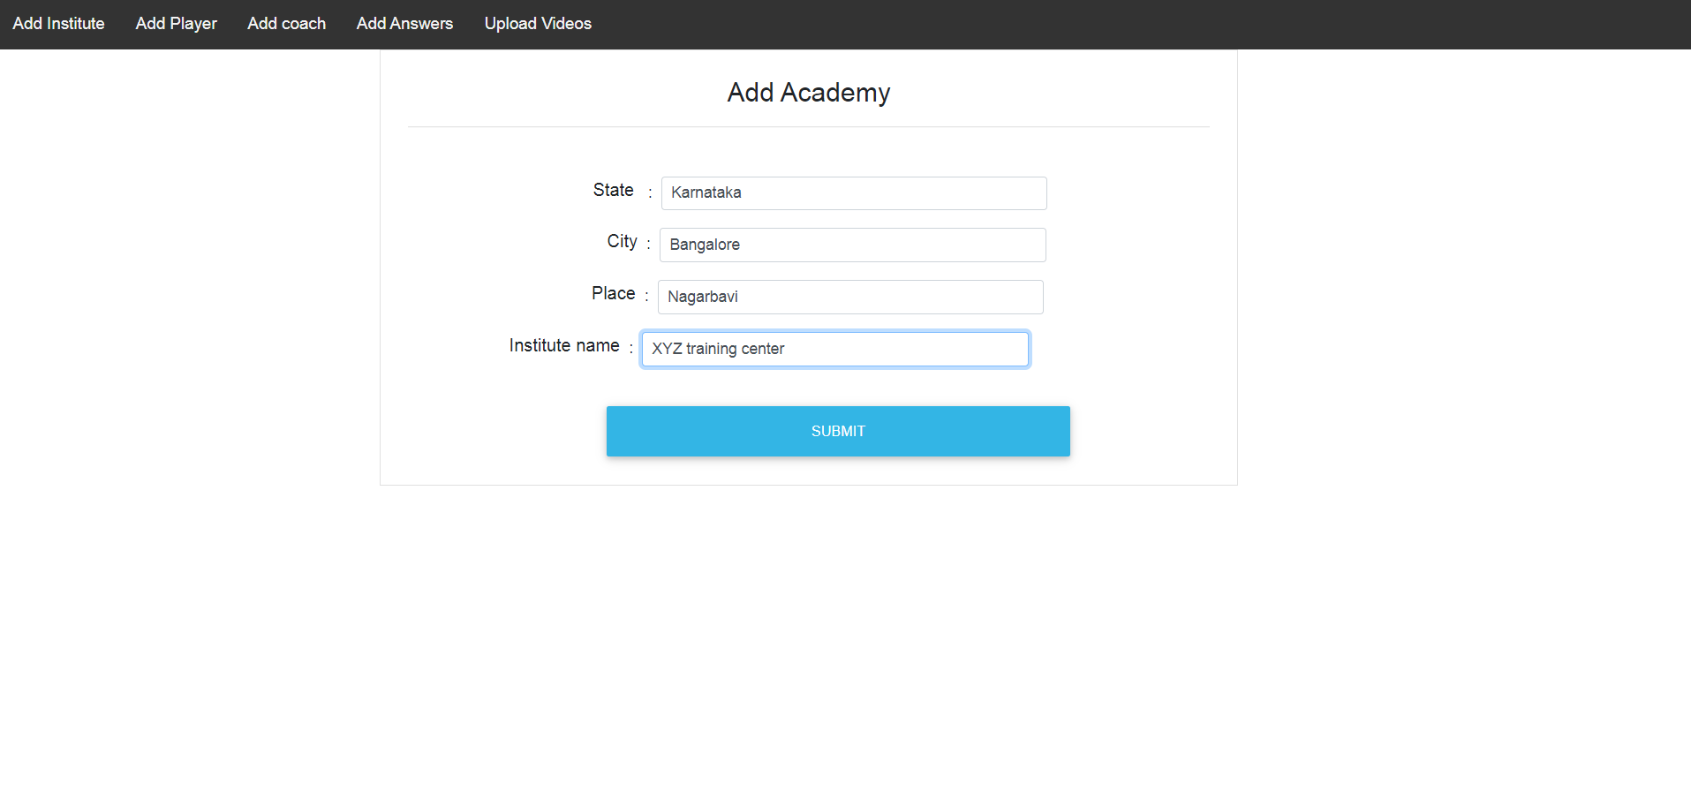
Enter the institute name.

Slide 11
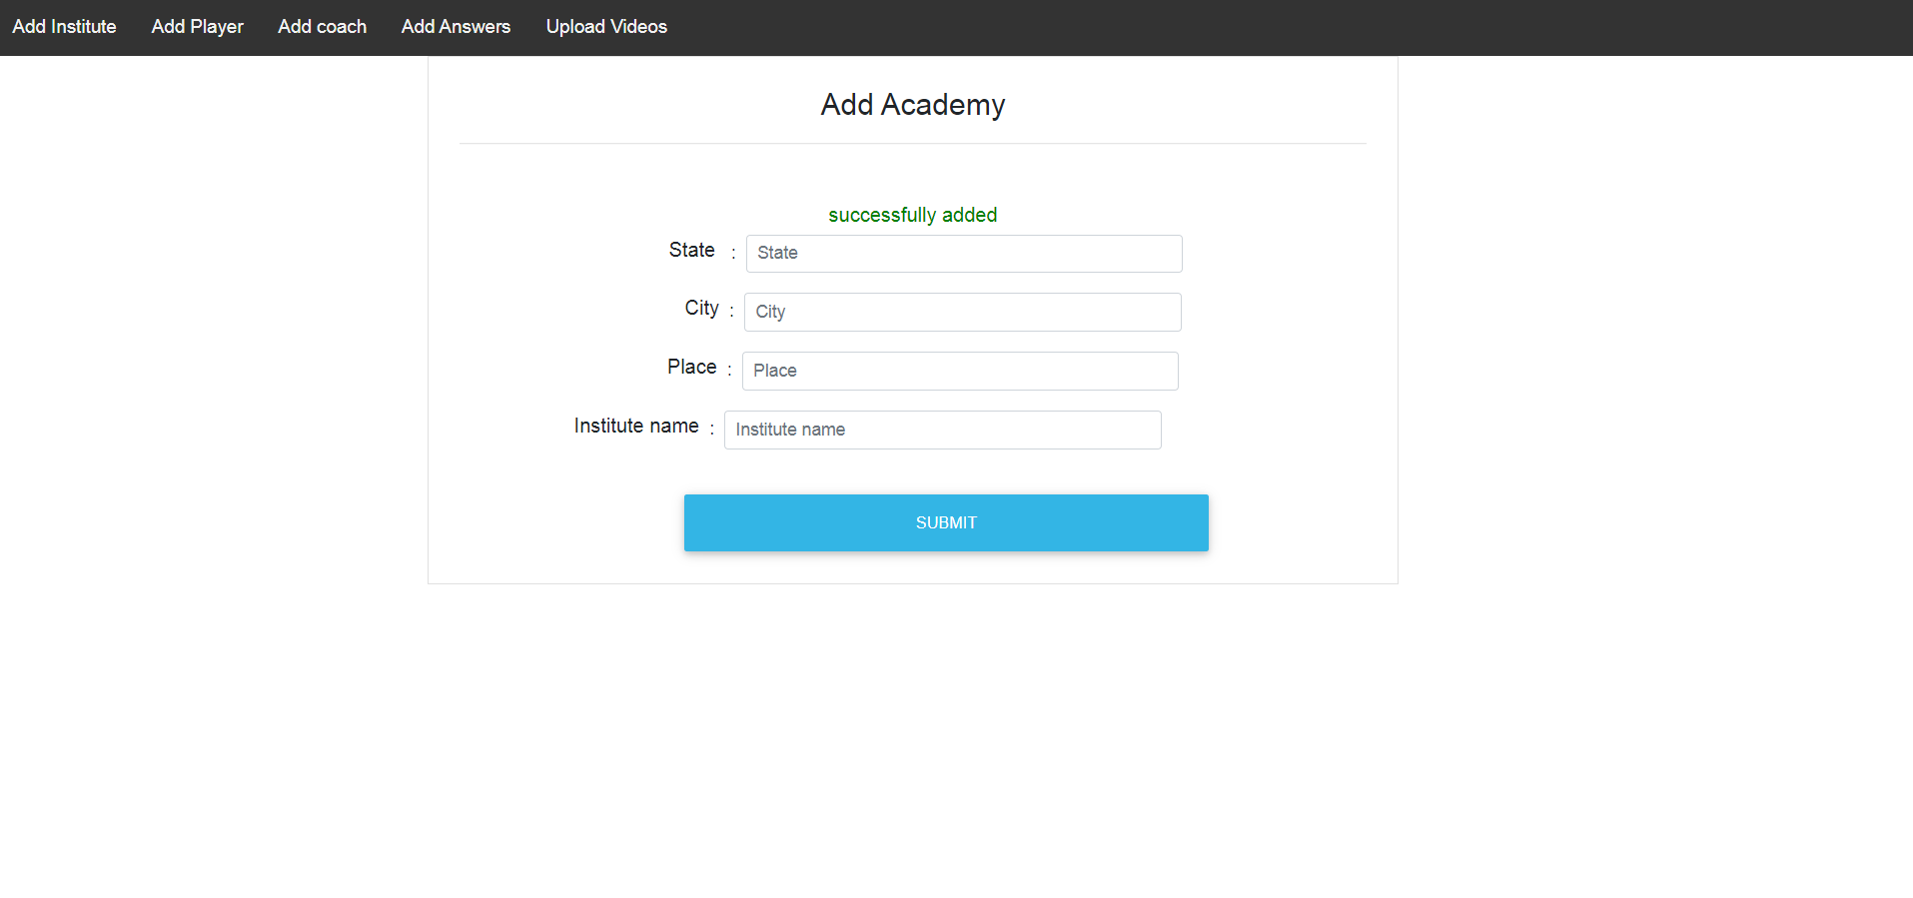
The institute added successfully on to the server.

Slide 12
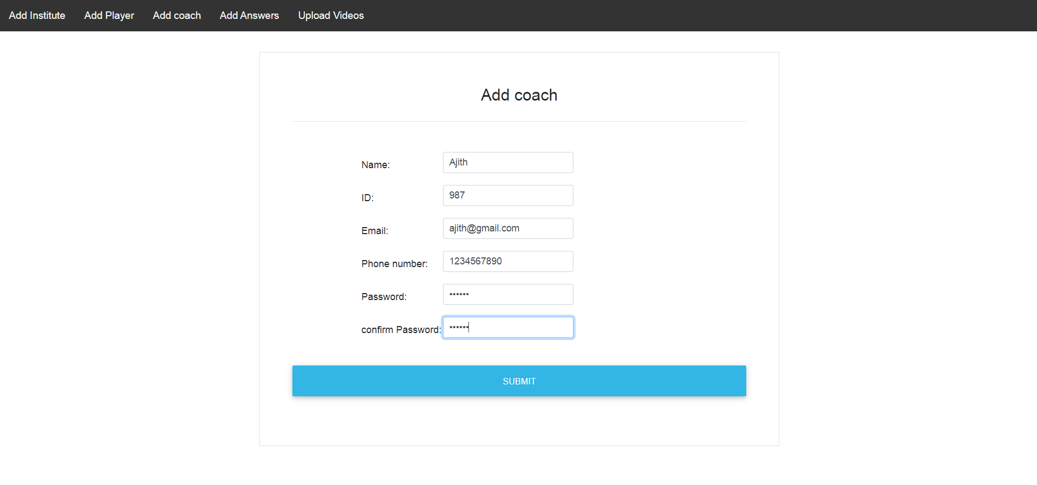
On Clicking the Add coach, admin can add new coach, which is also coach registration page. Fill the required fields in the form and submit.

Slide 13
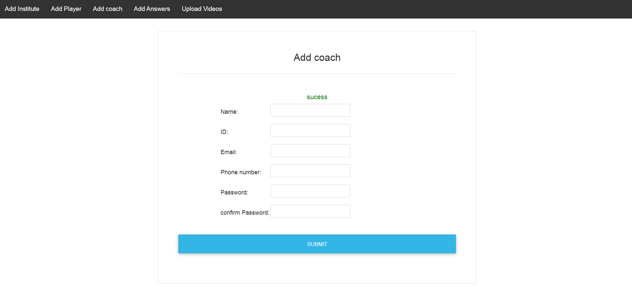
Coach registered successfully

Slide 14
Entering the same details will lead to unsuccessful registration. The ID and Email should be unique from previously added coach information to avoid unsuccessful registration.

Slide 15
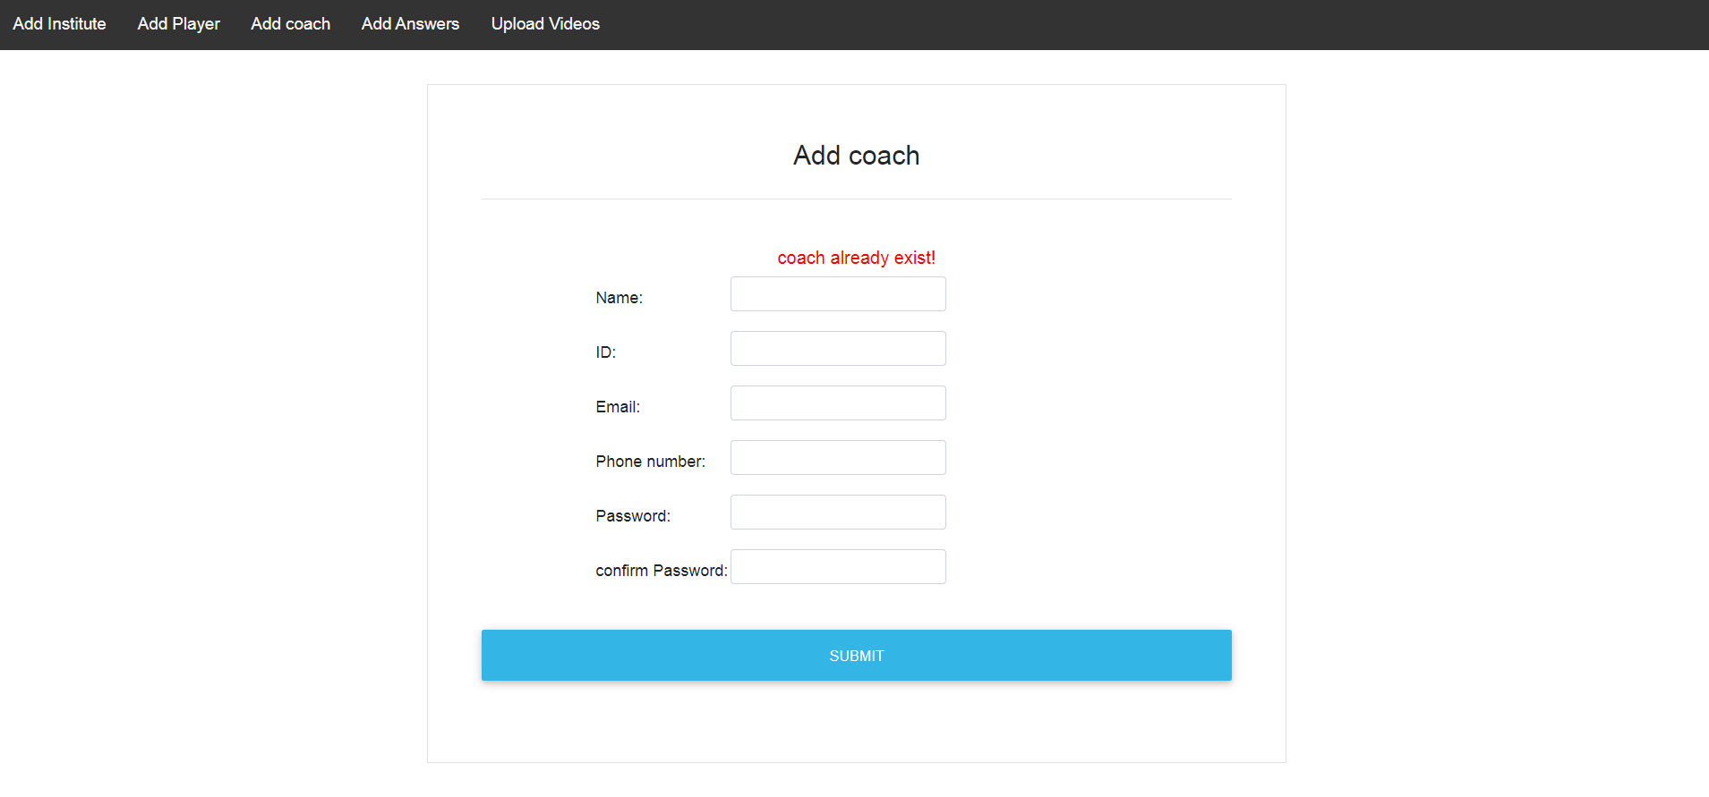
unsuccessful registration when entered the same details.

Slide 16
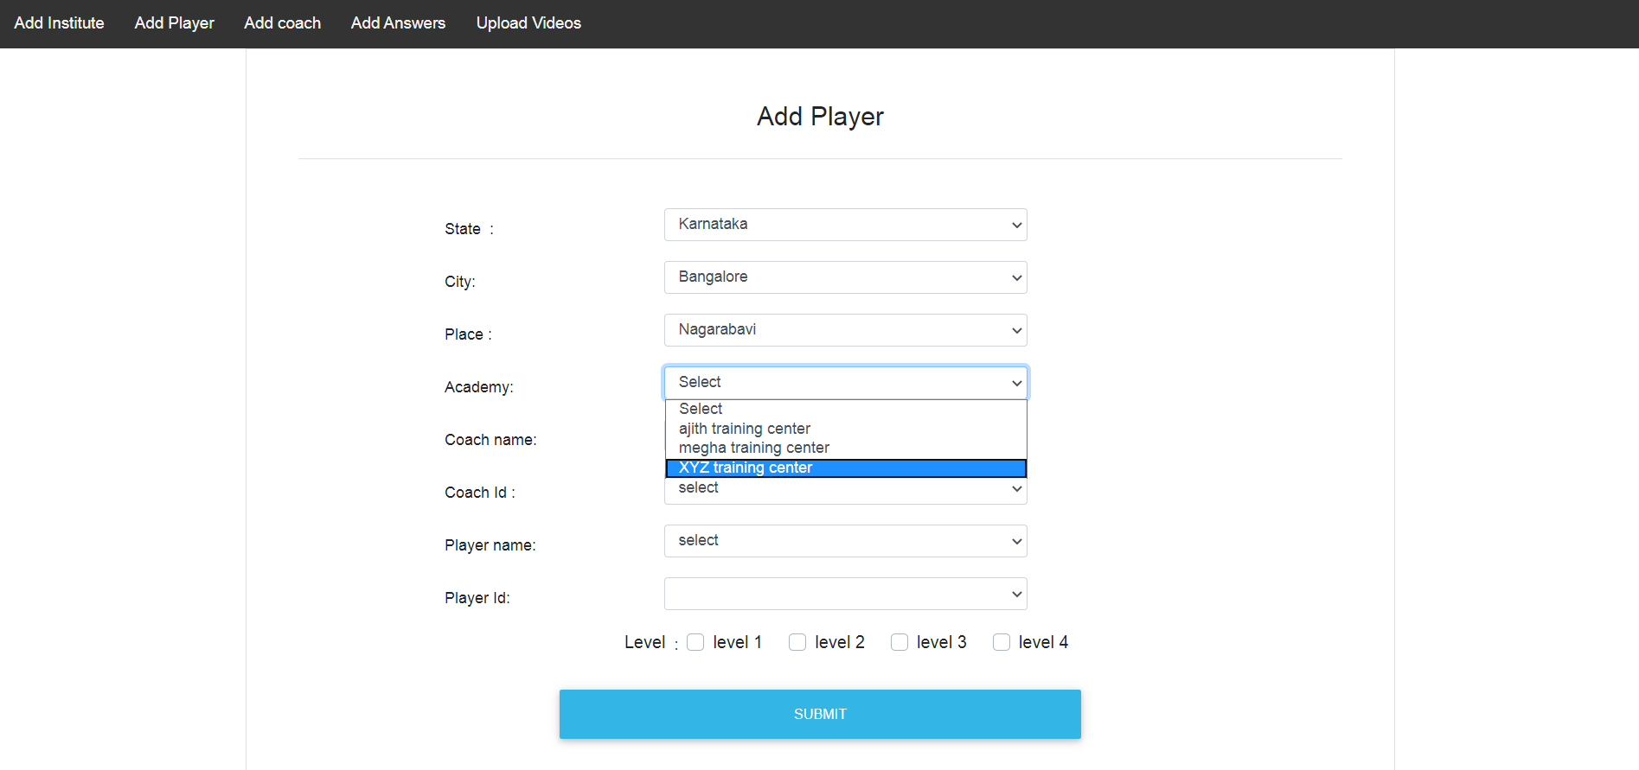
Add Player is the module which maps the player who are registered from android phone to the coach.Enter the required field.

Slide 17
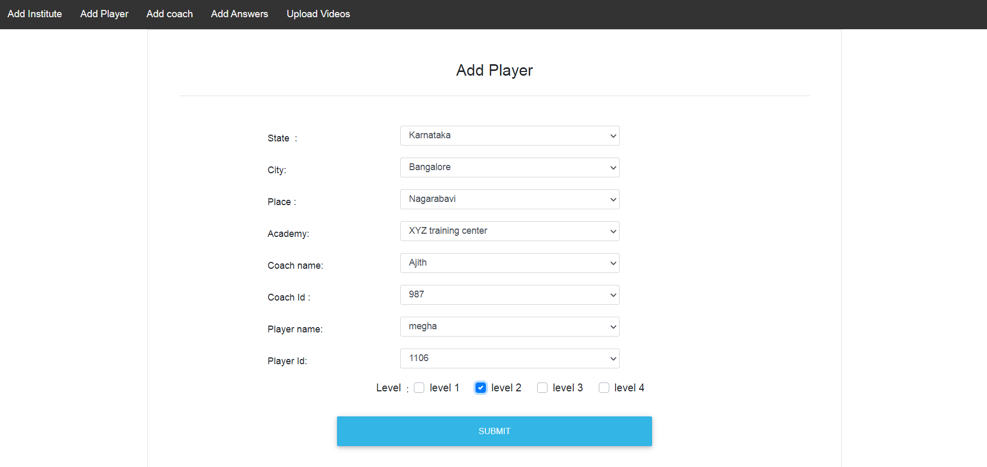
Select coach name, coach Id, player name, player Id and level which is displayed based on the location which is selected from the dropdown.

Slide 18
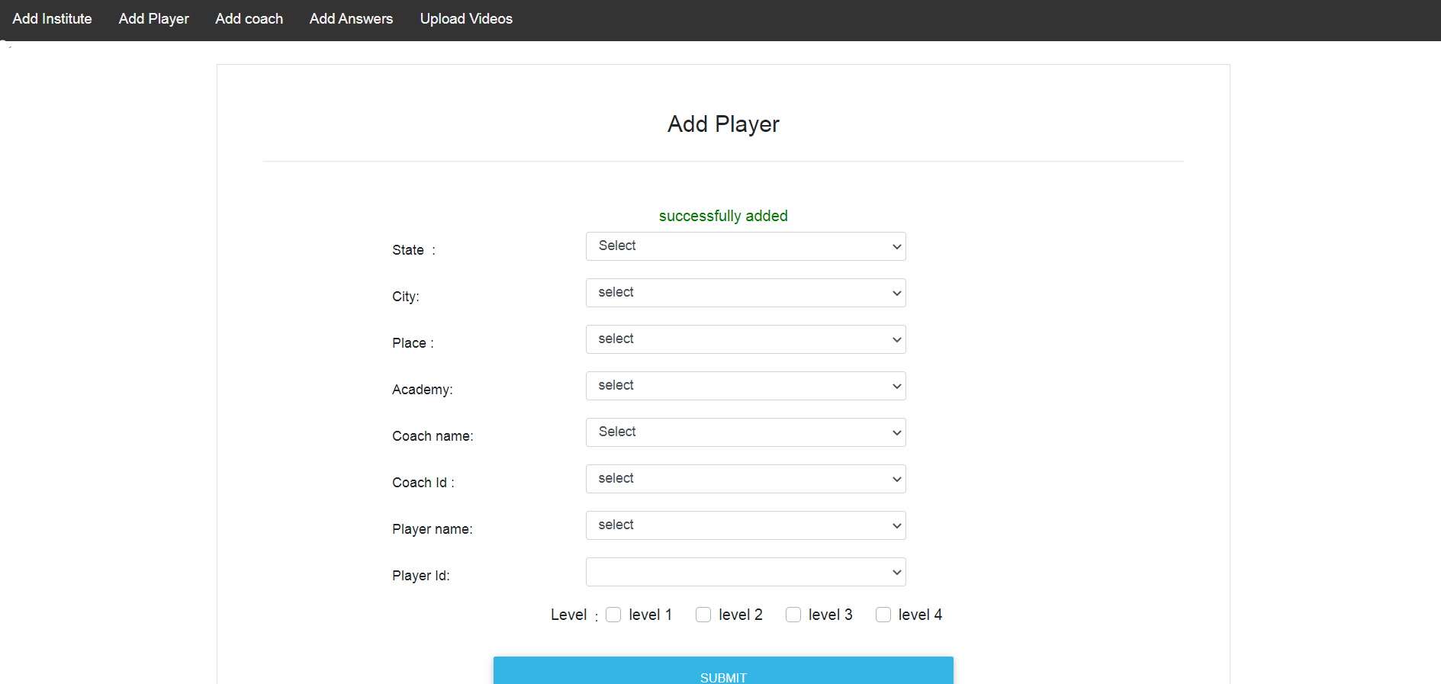
Successful mapping of player and coach.

Slide 19
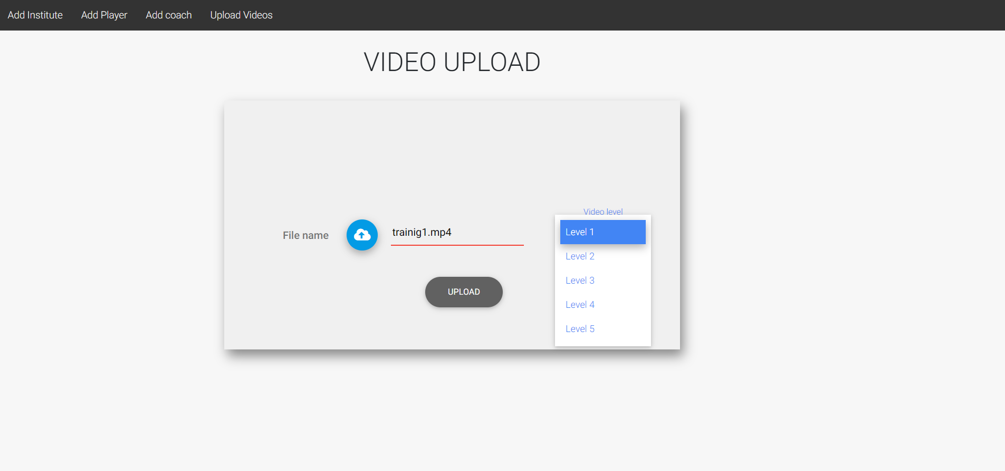
Admin selects different videos from local system and selects different level for the video.

Slide 20
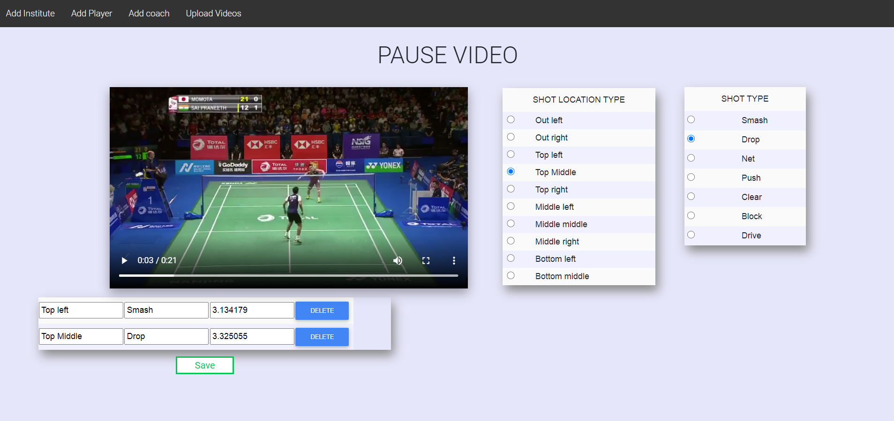
On successful upload of video, redirects to add answers(shot location type and shot type) and
pauses for the uploaded video.

Slide 21
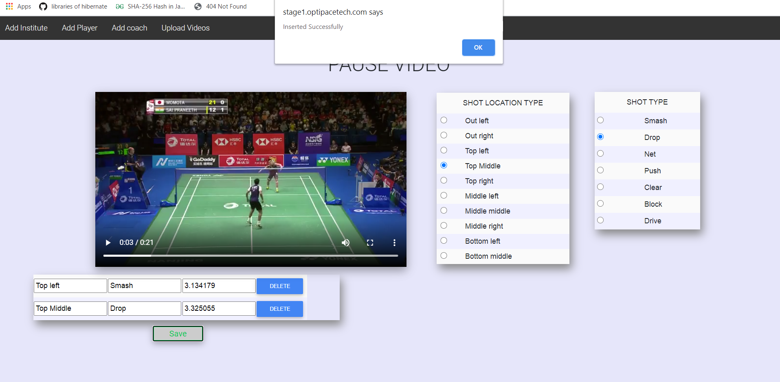
successfully adding the answers by clicking on save button.

